Slide 1
Introducción a la programación en Matlab
Dr. Luis Sanchez

Slide 2
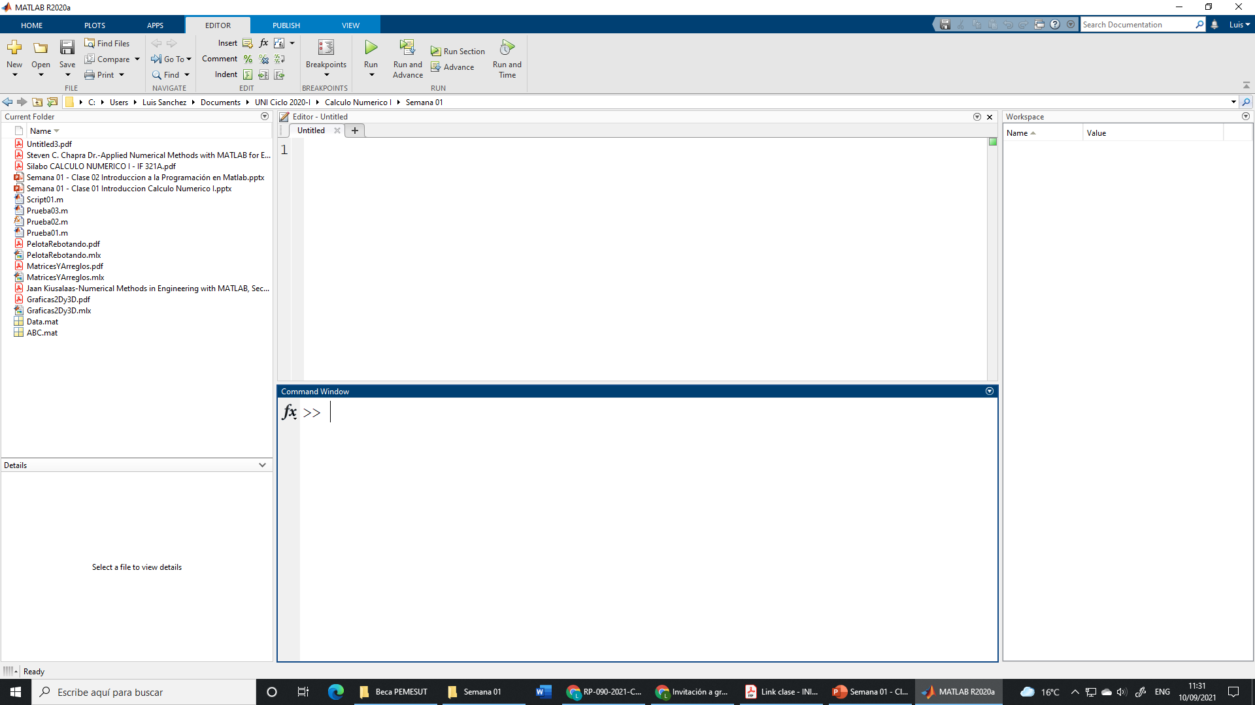
Matlab 2020 a
Editor
Workspace
Current Folder
Command Windows

Slide 3
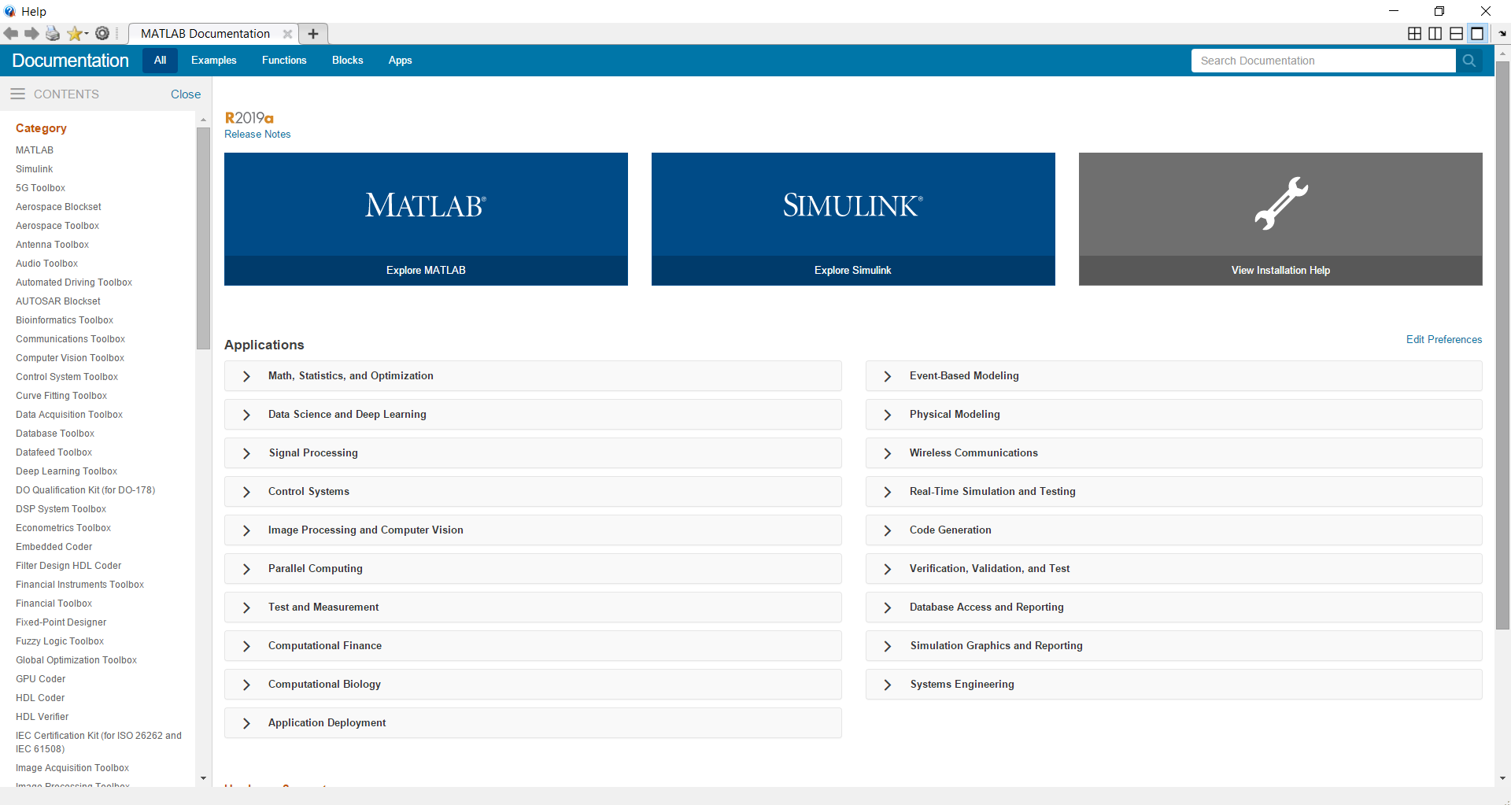
Matlab Help

Slide 4
MATLAB Basics
A program can be input
Command by command using the command line (lines starting with “»” on the MATLAB desktop)
As a series of commands using a file (a special file called M-file)
As a .mlx (Live script)
If a command is followed by a semicolon (;), result of the computation is not shown on the command window
All numbers are double precision
Text is stored as arrays of characters
You don’t have to declare the type of data (defined when running)
MATLAB is case-sensitive!!!

Slide 5
Matlab Operaciones Básicas
Sum: +
Difference: -
Multiplication: *
Division: /
Power: ^
Square root: sqrt()
Exponential: exp()
Logarithm: log()
…
Command Window
>> 2+2
ans =
4
>> 2^3
ans =
8
>> sqrt(2)
ans =
1.4142
Useful: Key ↑ brings back the past.

Slide 6
Variables
Variable: Object that stores information, and which can be used in operations.
Command Window
Workspace
>> a=2
a =
2
>> b=3;
>> a+b
ans =
5
>> a*(b+2)
ans =
10
>> resultado=b+a^2
resultado =
7
a 2
ans 10
b 3
resultado 7
Create variable a and assign value 2.
Semicolon (;) prevents visual output
Parentheses to group operations
Usually we assign the result of an operation to another variable (otherwise, it goes to ans)

Slide 7
Variables
They can have any name, except:
Names beginning by numbers.
Names with "strange" characters (ñ,ó,?, etc) or reserved characters (+,-,*,/,^, etc.)
Names used for other functions (this is especially dangerous. Matlab will not issue an error, but the function whose name you have used will not work until the variable is deleted).
Valid names:
a
chopo
Gr17
a7jD28r14
Non-valid names:
1gatito (starts by a number)
a+b (includes character “+”, reserved for summation).
Not recommended:
disp (it is the name of a function)
To check if a name is used by a Matlab function, just type it in Command Window. If matlab says
??? Undefined function or variable 'nombre'.
Then you can use it.
Matlab distinguishes between upper-case and lower-case characters
Variable gatito is NOT the same as variable Gatito.

Slide 8
Variables
Basic types
Text (also known as Characters). It goes between apostrophes. Example: ‘Hola’ is text. Hola (without apostrophes) is understood by Matlab as the name of a variable or a function
Numbers.
Definition of variables
Variables are created the first time they are defined. If the variable already exists, it is overwritten.
Examples:
>> a = 17
a =
17
>> b = ‘Hola’
b =
Hola
>> c = a
c =
17
>> b=14
b =
14

Slide 9
Self-referent variable operations
>> b = 1;
>> b = b + 1
b =
2
This is the old value of variable b (in this case, 1)

Slide 10
Variables
Initialization using shortcut statements
colon operator → first:increment:last
x = 1:2:10
x = 1 3 5 7 9
y = 0:0.1:0.5
y = 0 0.1 0.2 0.3 0.4 0.5
vector = [ 1 2 3 4 ]
vector = 1 2 3 4
matrix = [ 1 2 3; 4 5 6 ]
matrix = 1 2 3 4 5 6
matrix = [ 1 2 3; 4 5 ]
??? Error
a = [ 5 (2+4) ]
a = 5 6

Slide 11
Matrices
transpose operator → '
u = [ 1:3 ]'
u = 1 2 3
v = [ u u ]
v = 1 1 2 2 3 3
v = [ u'; u' ]
v = 1 2 3 1 2 3
Initialization using built-in functions
zeros()
x = zeros(2)
x = 0 0 0 0
z = zeros(2,3)
z = 0 0 0 0 0 0
ones(), size(), length()
y = zeros(1,4)
y = 0 0 0 0
t = zeros( size(z) )
t = 0 0 0 0 0 0

Slide 12
Matrices
Some useful commands:
zeros(n) | Returns a n X n matrix of zeros
zeros(m,n) | Returns a m X n matrix of zeros
ones(n) | Returns a n X n matrix of ones
ones(m,n) | Returns a m X n matrix of ones
size(A) | For a m X n matrix A, returns the row vector [m,n] containing the number of rows and columns in matrix
length(A) | Returns the larger of the number of rows or columns in A

Slide 13
Displaying Data
The fprintf( format, data ) function
%d integer
%f floating point format
%e exponential format
\n new line character
\t tab character

Slide 14
Displaying Data
fprintf( 'Result is %d', 3 );
Result is 3
fprintf( 'Area of a circle with radius %d is %f', 3, pi*3^2 );
Area of a circle with radius 3 is 28.274334
x = 5;
fprintf( 'x = %3d', x );
x = 5
x = pi;
fprintf( 'x = %0.2f', x );
x = 3.14
fprintf( 'x = %6.2f', x );
x = 3.14
fprintf( 'x = %d\ny = %d\n', 3, 13 );
x = 3 y = 13

Slide 15
save, load, clear
Delete variables
To delete ALL variables:
>> clear all
To delete only some variables:
>> clear pepito juanito
Only deletes variables pepito and juanito
Save and load variables
To save ALL variables to a file called nombrearchivo.mat:
>> save nombrearchivo
To save only some variables:
>> save nombrearchivo pepito juanito
To load the variables stored in file nombrearchivo.mat:
>> load nombrearchivo

Slide 16
The first program of any programmer
>> disp(‘¡Hola, mundo!’)
¡Hola, mundo!

Slide 17
Scripts
>> edit name_of_program
Any instruction in the script will be executed as if it had been typed in the Command Window.
Comments: Matlab ignores anything that follows the symbol %.
Example:
>>b=7; % Matlab will assign the value 7 to variable b, and will not read this sentence.

Slide 18
Execution of scripts
Once it has been saved, the script is executed by typing its name in the Command Window.
BUT NOTE:
Matlab will only look for programs in a few directories. If your script is not in one of those directories, Matlab will not be able to find it. These folders are:
Current directory: Indicated at the top of Matlab's window.
Matlab's path: It is a list of directories where Matlab always looks for programs. You can add a new directory to the path in the menu File→Set path…

Slide 19
Functions
Functions describe subprograms
Take inputs, generate outputs
Have local variables (invisible in global workspace)
[output_arguments]=function_name(input_arguments)
% Comment lines
<function body>
factfun.m
function [z]=factfun(n) % FACTFUN – Compute factorial % Z=FACTFUN(N)
z = prod(1:n);
>> y=factfun(10);

Slide 20
Scripts or function: when use what?
Functions
Take inputs, generate outputs, have internal variables
Solve general problem for arbitrary parameters
Scripts
Operate on global workspace
Document work, design experiment or test
Solve a very specific problem once
Exam: all problems will require you to write functions
facttest.m
% FACTTEST – Test factfun
N=50; y=factfun(N);

Slide 21
Flow control: if
if
Condition
if a>b
disp('a is greater than b')
end
disp('program continues')
Code executed if the condition is true
end
Afterwards, the program continues
Main types of conditions:
a==b → a equal to b (with two equal signs)
a~=b → a different than b (symbol ~ is typed with AltGr+4)
a>=b → a greater or equal than b
a<=b → a less or equal than b
a>b → a greater than b
a<b → a less than b
The comparison may involve variables or numbers (for example, a==1)

Slide 22
Flow control: if...else
if
Condition
if a>b
disp('a is greater than b')
else
disp('a is less or equal than b')
end
disp('Program continues')
Code executed if the condition is true
else
Code executed if the condition is false
end
Afterwards, the program continues

Slide 23
Flow control: if...elseif...else
if
Condition
if a>b
disp('a is greater than b')
elseif a<b
disp('a is smaller than b')
else
disp('a is equal as b')
end
Code executed if the condition is true
elseif
The second condition is tested ONLY if the first condition is false
Code executed if the first condition is false and the second condition is true
else
Code executed if both the first and the second conditions are false
end

Slide 24
The for loop
Loop: Set of instructions that are repeated several times.
Counter variable, which goes from one to ten, in steps of one
for
for c = 1:1:10
disp('This will be shown 10 times')
vector(c)=c+7;
end
Portion of the code that is repeated
end
The counter variable may be used inside the loop. This variable is different each iteration (in this case, its value is 1 the first iteration, 2 the second iteration, etc.

Slide 25
Flow control – conditional repetition
while-loops
while <logical expression>
<statements>
end
<statements> are executed repeatedly as long as the <logical expression> evaluates to true
k=1;
while prod(1:k)~=Inf,
k=k+1;
end
disp([‘Largest factorial in Matlab:’,num2str(k-1)]);

Slide 26
Programming tips and tricks
Programming style has huge influence on program speed!
slow.m
fast.m
tic;
X=-250:0.1:250;
for ii=1:length(x)
if x(ii)>=0,
s(ii)=sqrt(x(ii));
else
s(ii)=0;
end;
end;
toc
tic
x=-250:0.1:250;
s=sqrt(x);
s(x<0)=0;
toc;
Loops are slow: Replace loops by vector operations!
Memory allocation takes a lot of time: Pre-allocate memory!
Use profile to find code bottlenecks!

